Slide 1
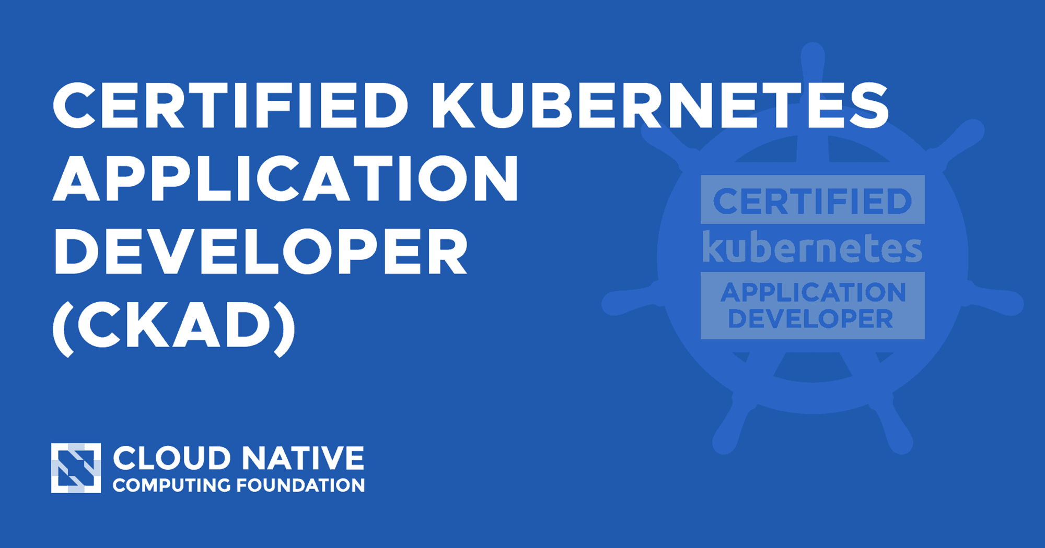


Made By: Hina Naseer linkedin.com/in/hina-naseer-ahmed-b6b33699
https://github.com/hinanaseer

Slide 2
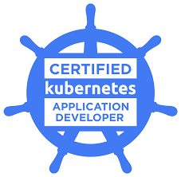
AGENDA
Why do you need an CKAD exam?
Is the CKAD exam difficult?
CKAD Exam prerequisites ?
What are Exam Details ?
What are Exam Resources ?
We will Discuss Exam Syllabus
Best Exam Practice Lab Setup
What are Best CKAD preparation Courses
Necessary environment for Exam
What Strategy need to follow to pass the Exam
How do I register for the exam?

Slide 3
Why do you need an CKAD exam?
Kubernetes is the future of infrastructure and almost every company is adopting nowadays. This is one of the most sought after skills that companies need right now.
Almost every company is either converting their legacy applications into cloud-native apps or building new apps which are cloud-native. Kubernetes is the only container orchestration framework available in the market other than docker swarm when it comes to deployment of these apps.
So, this is the right time for anyone to take this exam not only prove their expertise in this field but also strengthen your Kubernetes skills.

Slide 4
Is the CKAD exam difficult?
Yes, Kubernetes and passing the CKAD exam can be difficult. But with the right resources and time, any developer can get up to speed with Kubernetes and pass the CKAD exam.
CKAD Exam prerequisites ?
YAML/JSON knowledge: All Kubernetes objects can be created via YAML or JSON files. But YAML is widely used since its simple. So it is good to have YAML knowledge.
Linux Knowledge: For the ones who never worked on Linux based OS, it’s highly recommended to take Beginners course of Linux, knowledge of networking in Linux is also required to some extent if you are going for CKAD.
Vim editor: While preparing for the exam, you will quite often need to create and modify files. If you are new to Vim, check below: Practice Vim: https://github.com/damassi/learn-vim Vim cheat sheet: https://devhints.io/vim
Docker Knowledge: As Kubernetes is a container orchestrator; before you start preparing for CKAD or CKA, having prior knowledge of docker is a must. If you are new to the container world, I’d advise you to take a course on one of the following learning portals: Udacity, Udemy, edX.

Slide 5
What are Exam Details ?
This exam is a performance-based exam, it doesn’t have any multiple-choice questions.
You will be given a set of performance-based problems to be solved in a command line and is expected to take approximately two hours to complete.
You should solve 19 questions in 2 hours and every question has a different weight.
The passing score for this exam is 66%. The cost of this exam is $395 USD and you will get one free retake and it is valid for 2 years. The exam includes questions from the following topics:

Slide 6
The exam includes questions from the following topics
Core Concepts (13%)
Configuration (18%)
Multi-Container Pods (10%)
Observability (18%)
Pod Design (20%)
Services & Networking (13%)
State Persistence (8%)
https://github.com/dgkanatsios/CKAD-exercises
https://rudimartinsen.com/ckad-resources

Slide 7
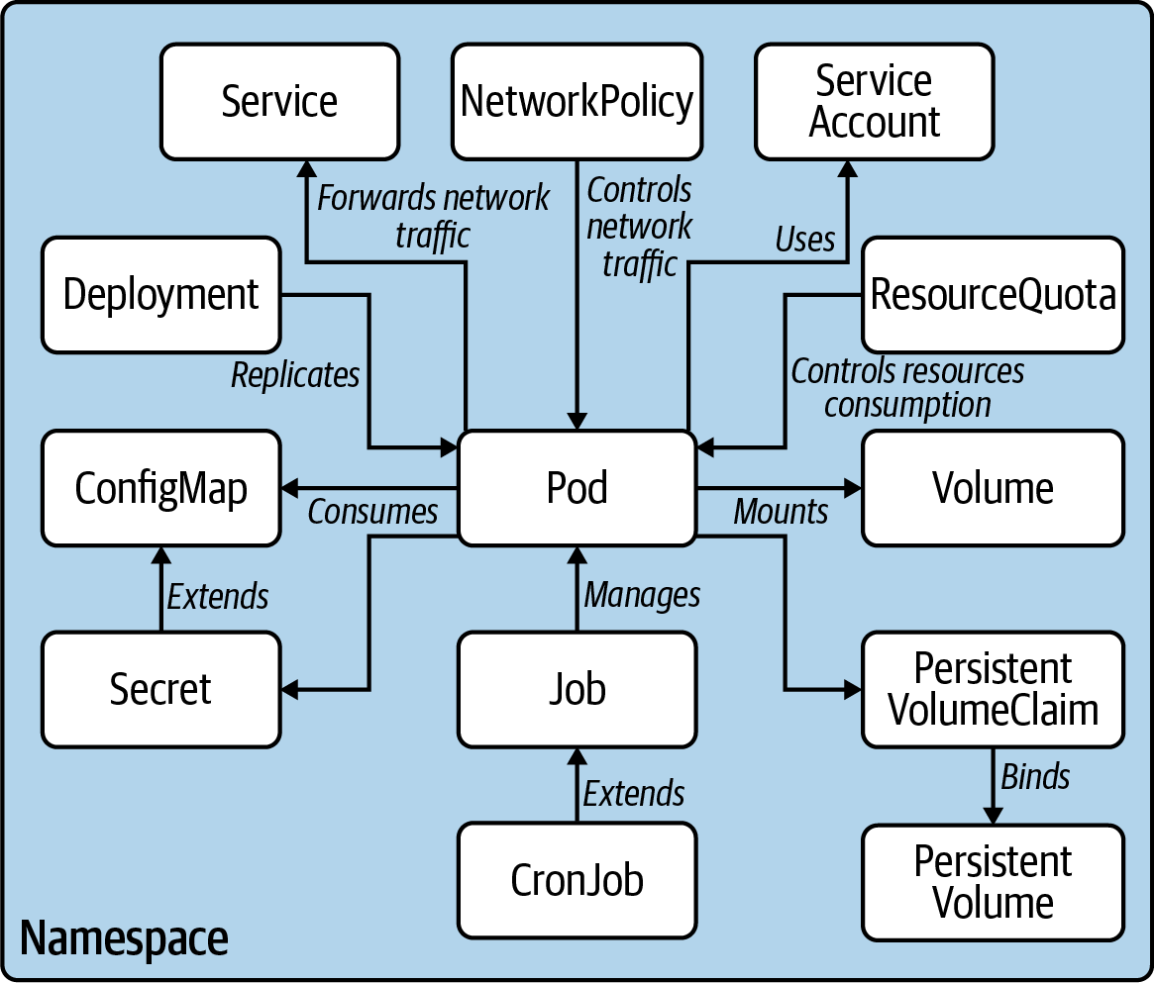

Slide 8
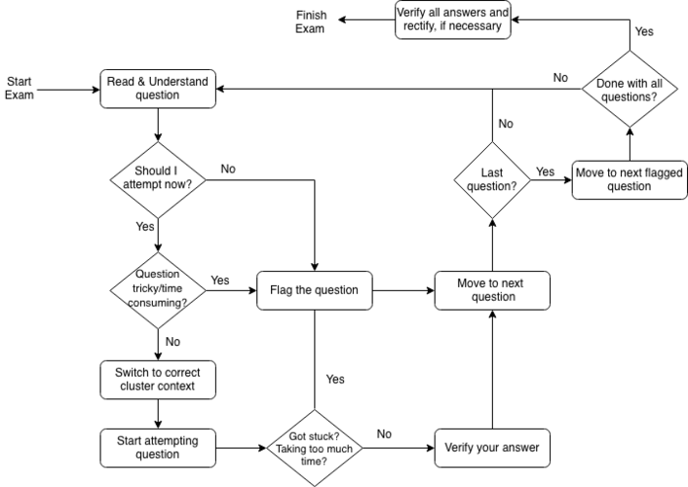
Time Management

Slide 9
CKAD Exam Resources
CKAD Kubernetes Developer Online Course
LinkedIn Learning (Free trial) | Kubernetes Dev. Cert. Preparation Exam Tips
Pluralsight | Learning Path: Developer Certificate Exam
Whizlabs | Kubernetes App Developer Course
Udemy | K8s Dev. Exam Preparation by Zeal Vora
Kubernetes App Developer Practice Test/Book
Udemy Practice Tests | Kubernetes Application Developer practice test
Amazon e-book (PDF) | Kubernetes Application Developer Study Guide
CKAD Kubernetes Developer Learning Materials
Linux Foundation Bootcamp | Cloud Engineer Bootcamp [24 weeks]
Coursera | Fundamentals of Kubernetes Deployment

Slide 10
Continue…
Kubernetes docs | https://kubernetes.io/docs/home/
Kubernetes.io tasks | https://kubernetes.io/docs/tasks/
kubectl cheatsheet | https://kubernetes.io/docs/reference/...
Kubernetes imperative commands | https://youtu.be/QOv26a-yaq8
E Learning Resources
Linux Foundation CKAD + Kubernetes for developers bundle - | https://training.linuxfoundation.org/...
Udemy Kubernetes Certified Application Developer (CKAD) with Tests | https://www.udemy.com/course/certifie...
kubectl cheatsheet | https://kubernetes.io/docs/reference/...
Kubernetes imperative commands | https://youtu.be/QOv26a-yaq8

Slide 11


Continue…
Github Repos
CKAD Exercises | https://github.com/dgkanatsios/CKAD-e...
CKAD resources | https://github.com/lucassha/CKAD-reso...
Nilesh Gule CKAD exam prep | https://github.com/NileshGule/ckad-ex...
Denny Zhang kubectl cheatsheet | https://github.com/dennyzhang/cheatsh...
Ahmet Alp Balkan Kubernetes network policy recipes | https://github.com/ahmetb/kubernetes-...
Blogs
Be fast with kubectl - https://faun.pub/be-fast-with-kubectl...
How to nail Kubernetes certification exams - https://www.infoworld.com/article/363... Codefresh Kubernetes cheatsheet - https://codefresh.io/kubernetes-tutor...
CKAD practical challenge series - https://codeburst.io/kubernetes-ckad-...

Slide 12
Practice Enough With These 150 Questions for the CKAD Exam
https://link.medium.com/9TsVOAsF5tb
Kubernetes CKAD Example Exam Questions Practical Challenge Series
https://link.medium.com/ddYQUpeQZtb
CKAD exam Preparation Notes and Practice Questions: Part 1
https://link.medium.com/z6AB9foI8tb
CKAD exam Preparation Notes and Practice Questions: Part 2
https://blog.prateekjain.dev/ckad-exam-preparation-notes-and-practice-questions-part-2
CKAD exam Preparation Notes and Practice Questions: Part 3
https://link.medium.com/7KzqqQWH8tb

Slide 13
CKAD Exam Practice Lab Setups
The best way to prepare is to practice a lot! The below setups will give you a Kubernetes cluster where you can do all the required practice. The exam expects you to solve problems on a live cluster. CKAD does not have any MCQ-type format – so hands-on practice is a must.
Killercoda
Minikube
Kubernetes Setup using Kubeadm [Detailed Guide]
Kubernetes Vagrant Setup using Kubeadm
GKE Cluster using free Google Cloud Credits
EKS Service on AWS using Free tier program
AKS service on Azure using free cloud credits
Kubernetes Cluster on Digital Ocean[ Get $100 Digital Ocean Free Credits]

Slide 14

Tips
Identification – before the exam, all candidates are supposed to present a photo identification that is issued by the government. In most cases, your international passport is sufficient. You can read the Candidate Handbook for more information.
Testing Room – for the test, you need to prepare a room. This room should be well-lit, private, and quiet.
Virtual screen – tmux and screen is a virtual screen to get. The use of multiple monitors is going to be helpful to you. In such a situation, you can look up the Kubernetes resource state and log on to one screen while deploying Kubernetes resources on the other one.
Command aliases – to further reduce the time you require to type in commands, it is helpful to set up an alias or aliases.

Slide 15
5. Searchability – you can search and make use of the Kubernetes.io pages. Never give up when you do not have an idea on any of the exam questions. Search through the Kubernetes.io pages by typing some keywords and searching. On this website, you could get lucky with discovering some right answers or hints.
6. Manage your time well – avoid awkward questions. In other words, save your time and do not waste time on any questionable items. You can spend the remaining time you have on these difficult questions. However, it would be best if you endeavored to attempt all the easy questions first. To pass the exam, you do not have to beat everything. Passing the exam requires scores of at least 66% in the CKAD and at least 74% in the CKA.

Slide 16
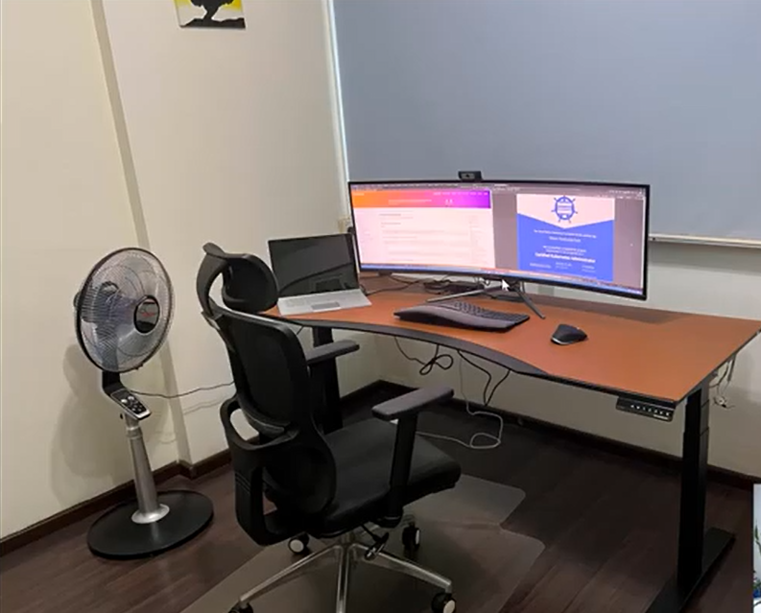

Slide 17
Tips cont…
Imperative commands the best friend.
Practice more and more with the kubernetes imperative commands rather than the declarative approach.
It always saves time and always helps you solve problems efficiently.
For more details on imperative commands and be fast with kubectl.
Be fast with Kubectl 1.18 (CKAD/CKA)
Collection of the fastest ways to create k8s resources using kubectl ≥ 1.18medium.com

Slide 18

CKAD Do’s
While giving practice exams, try to wrap up 15 minutes before the deadline – it will give you additional time to revise the solutions.
Give a lot of practice exams, identify your weak topics and spend more time on those.
On the exam day, keep an alternative internet source handy in case of Wi-Fi internet goes down. We don’t want all our hands works to be wasted, do we?
If any particular question is going to take more than 6-7 mins to solve, flag/mark it to solve for later and come back once you solve the rest.

Slide 19

CKAD Dont’s
Most people don’t even use an alias. So no need to overwhelm yourself with an alias for everything.
Don’t give the exam on the last day. The idea is to give it in a pressure-free environment.
At the time of the exam, you shouldn’t have anything on the table other than your system.

Slide 20

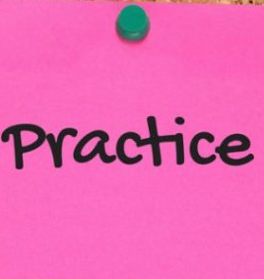

Practice, practice and practice.
Make sure you practice all the topics and all the labs on the Kodecloud as shared by Mumshad Mannambeth’s course.
Whenever you get any question on any topic, just practice and learn it by doing.
Look out for videos again if there is any confusion in mind.

Slide 21
Frequently asked Questions about CKAD Exam
Q1. Can we bookmark some links for use during the exam?
Yes, as long as you are using the links from official Kubernetes docs.
Q2. What if the internet connection goes down suddenly?
The exam software saves your progress at frequent intervals, so you won’t lose all your work.
Q3. How many questions does the exam have?
Around 17-20 questions, based on the figures by multiple candidates.
Q4. Does each question carry equal weightage?
No, the weightage of questions varies from 2% to 13%.
Q5. How do we keep a track of time during the exam?
The exam software displays a timer on the top of the screen at all times.

Slide 22
I hope this helps everyone who is looking to pass the exam. Happy Learning!!!

